Slide 1
Sound Design
For General Music (Grades 6-12)
Music and the art of Foley
Notes:
If you want to have students record in a DAW, they will need to know how to record audio and how to split and trim regions (if you haven’t taught these skills they can be quickly covered!).
Here are some useful Soundtrap video tutorials:
Crash Course: https://vimeo.com/196264186
Basic region editing: https://vimeo.com/196852600
Recording audio: https://vimeo.com/196269023

Slide 2
Students will:
Essential Questions:
Add foley and elements of musical expression such as dynamics, tempo, register, and articulation to a piece of text.
When is a creative work ready to share?
How does technology change or influence the way music is made?

Slide 3
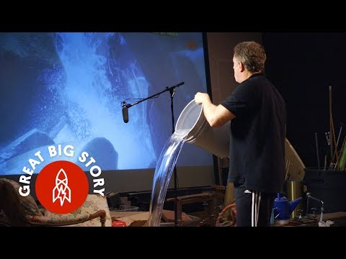
Foley - The Magic of Making Sound

Slide 4
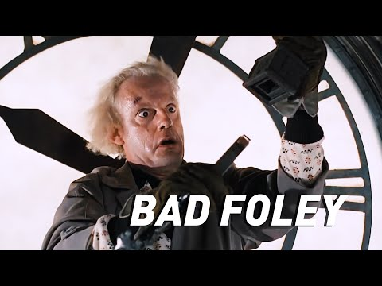
Bad Foley with Back to the Future

Slide 5
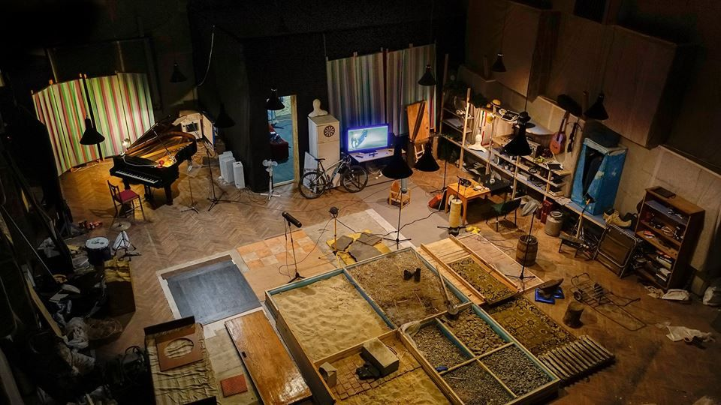
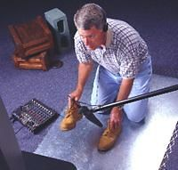
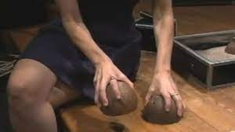
Foley Defined:
The reproduction of everyday sounds for film, video, and other media in post-production to enhance the audio.
Notes:
Source: https://www.studiobinder.com/blog/what-is-a-foley-artist/
Pictures:
-https://www.videomaker.com/article/7220-real-time-sound-effects-the-foley-way
-https://www.youtube.com/watch?v=Bh-wZ3Tx6gA
-https://usv.edu/blog/the-foley-artist/

Slide 6
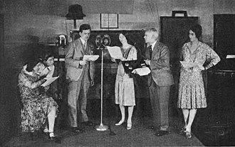
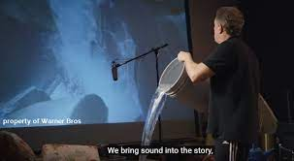
Foley History:
Originated from live radio drama broadcasts
Called “Foley” because of sound design artist Jack Foley (1891- 1967) who worked in the motion picture business in the silent picture era and lived through the exciting times when the industry converted to sound moving pictures.
The microphones of the times could only pick up dialogue
All other sounds had to be added afterwards!
Notes:
Source: https://www.studiobinder.com/blog/what-is-a-foley-artist/
Pictures:
-https://en.wikipedia.org/wiki/Foley_(filmmaking)
-https://www.openculture.com/2018/05/how-the-sounds-you-hear-in-movies-are-really-made-discover-the-magic-of-foley-artists.html

Slide 7
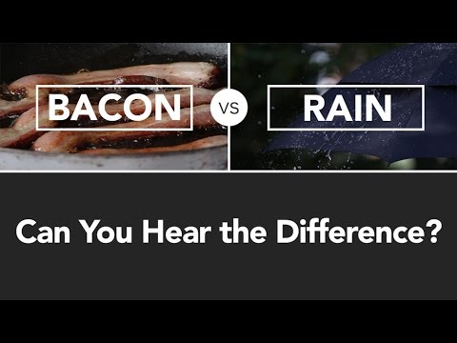
Use of Common Objects:
Coconuts = Walking Horse
Frying Bacon = Rain
Celery = Broken Bones
Newspaper = Grass
Aluminum = Thunder
Cellophane = Fire
Trash cans = Heartbeats
AND SO MANY MORE!
Notes:
Source: https://blog.storyblocks.com/inspiration/foley-sfx-everyday-household-objects/

Slide 8
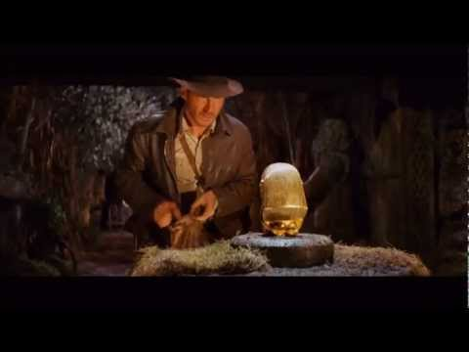
Importance of Foley:
List all the foley you hear.
What do you think made each sound?
(sample chart)
Notes:
Others to use or have students practice add Foley to (just turn the sound off!):
Toy Story- https://www.youtube.com/watch?v=aZ5qSbUbwhk
Ratatouille- https://www.youtube.com/watch?v=jwLKPDJqldw

Slide 9

Ducking ofVolume:
Ducking is when you lower the volume of other sounds when there is speech so that the speech or lyrics can be heard clearly.
Notes:
Helpful Resource:
How to fix audio issues in Soundtrap:https://www.youtube.com/watch?v=69jFzDTWNeg

Slide 10
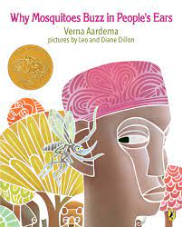

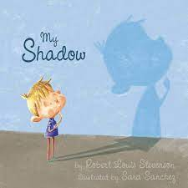
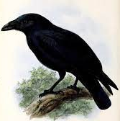
Let’s Enhance a Story or Poem!
Why Mosquitoes Buzz in People’s Ears by Verna Aardema
Text
Video Reading
Where the Wild Things Are by Maurice Sendak
Text
Video Reading
My Shadow by Robert Louis Stevenson
The Raven by Edgar Allan Poe
SO MANY MORE!
Notes:
Pick one! The following slides will use “Why Mosquitoes Buzz in People’s Ears” as an example.

Slide 11
What Sound Effects Do We Need?
Notes:
Have students brainstorm

Slide 12
What Sound Effects Do We Need?
Buzzing bees
Water
Hissing snakes
Loud animals roaring
Notes:
Sample response based on “Why Mosquitoes Buzz in People’s Ears”

Slide 13
What Classroom Instruments Could We Use?
Notes:
Have students brainstorm

Slide 14
What Classroom Instruments Could We Use?
Xylophones
Egg shakers
Rainstick
Thunderstick
Drums
Notes:
Sample response based on “Why Mosquitoes Buzz in People’s Ears”

Slide 15
Let’s Try it with Text: FOLEY! (put under)
One morning a mosquito saw an iguana drinking at a waterhole.
The mosquito said, “Iguana, you will never believe what I saw yesterday.”
“Try me,” said the iguana.
The mosquito said, “I saw a farmer digging yams that were as big as I am.”
“What’s a mosquito compared to a yam?” snapped the iguana grumpily.
“I would rather be deaf than listen to such nonsense!”
Then he stuck two sticks in his ears and went off, mek, mek, mek, mek, through the reeds.
Notes:
Have students brainstorm ideas for Sound Effects individually, in pairs, and then share out.

Slide 16

Let’s Try it with Text: FOLEY SAMPLE
One morning a mosquito saw an iguana drinking at a waterhole.
buzzing water/slurping
The mosquito said, “Iguana, you will never believe what I saw yesterday.”
buzzing
“Try me,” said the iguana.
The mosquito said, “I saw a farmer digging yams that were as big as I am.”
buzzing shoveling dirt
“What’s a mosquito compared to a yam?” snapped the iguana grumpily.
“I would rather be deaf than listen to such nonsense!”
Then he stuck two sticks in his ears and went off, mek, mek, mek, mek, through the reeds.
thump thump squish sounds
Notes:
Sample to show students

Slide 17
What Else Could We Adjust?
Notes:
See if you can get students to mention elements of musical expression such as register, tempo, dynamics, and articulation!

Slide 18


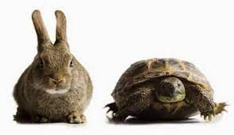
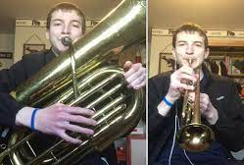
What Else Could We Adjust?
Articulation: The style (long, short or emphasized)
Dynamics: How loud or soft
Tempo: How fast or slow
Register: How low or high

Slide 19
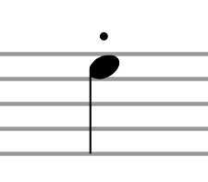

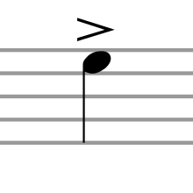
Let’s Review: Articulation
Articulation: The style of each note
Term: | Definition: | Symbol:
Staccato | Short and detached
Legatto | Long and connected
Accented | Emphasized

Slide 20
Let’s Try It with Text:
Articulation
Articulation Key: *above
. = staccato (short)
_ = legato (long)
> = accented (emphasized)
One morning a mosquito saw an iguana drinking at a waterhole.
The mosquito said, “Iguana, you will never believe what I saw yesterday.”
“Try me,” said the iguana.
The mosquito said, “I saw a farmer digging yams that were as big as I am.”
“What’s a mosquito compared to a yam?” snapped the iguana grumpily.
“I would rather be deaf than listen to such nonsense!”
Then he stuck two sticks in his ears and went off, mek, mek, mek, mek, through the reeds.
Notes:
Ask the students where you should say words short, long, or accented.
Have the students practice reading the text, experimenting with where to say words short, long, and accented. (individually, with a partner, share out, etc.)

Slide 21
Let’s Try It with Text:
Articulation Sample
Articulation Key: *above
. = staccato (short)
_ = legato (long)
> = accented (emphasized)
One morning a mosquito saw an iguana drinking at a waterhole.
_
The mosquito said, “Iguana, you will never believe what I saw yesterday.”
_
“Try me,” said the iguana.
>
The mosquito said, “I saw a farmer digging yams that were as big as I am.”
> >
“What’s a mosquito compared to a yam?” snapped the iguana grumpily.
.> .
“I would rather be deaf than listen to such nonsense!”
. . . .
Then he stuck two sticks in his ears and went off, mek, mek, mek, mek, through the reeds.
Notes:
Sample to show students

Slide 22
Let’s Review: Dynamics
Dynamics: The volume
Term: | Definition: | Symbol:
Pianissimo | Very quiet | pp
Piano | Quiet | p
Mezzo Piano | Medium/Somewhat Quiet | mp
Mezzo Forte | Medium/Somewhat Loud | mf
Forte | Loud | f
Fortissimo | Very Loud | ff
Crescendo | Gradually get louder
Decrescendo | Gradually get softer

Slide 23
Let’s Try It with Text:
Dynamics
Dynamics Key: *below
pp = pianissimo (very soft)
p = piano (soft)
mp = mezzo piano (med soft)
mf = mezzo forte (med loud)
f = forte (loud)
ff = fortissimo (very loud)
= crescendo (get louder)
= decrescendo (get softer)
One morning a mosquito saw an iguana drinking at a waterhole.
The mosquito said, “Iguana, you will never believe what I saw yesterday.”
“Try me,” said the iguana.
The mosquito said, “I saw a farmer digging yams that were as big as I am.”
“What’s a mosquito compared to a yam?” snapped the iguana grumpily.
“I would rather be deaf than listen to such nonsense!”
Then he stuck two sticks in his ears and went off, mek, mek, mek, mek, through the reeds.
Notes:
Ask the students what volume the text should be and where the volume should change.
Have the students practice reading the text, experimenting with dynamics. (individually, with a partner, share out, etc.)

Slide 24
Let’s Try It with Text:
Dynamics Sample
Dynamics Key: *below
pp = pianissimo (very soft)
p = piano (soft)
mp = mezzo piano (med soft)
mf = mezzo forte (med loud)
f = forte (loud)
ff = fortissimo (very loud)
= crescendo (get louder)
= decrescendo (get softer)
One morning a mosquito saw an iguana drinking at a waterhole.
mf
The mosquito said, “Iguana, you will never believe what I saw yesterday.”
“Try me,” said the iguana.
The mosquito said, “I saw a farmer digging yams that were as big as I am.”
“What’s a mosquito compared to a yam?” snapped the iguana grumpily.
f mf
“I would rather be deaf than listen to such nonsense!”
f
Then he stuck two sticks in his ears and went off, mek, mek, mek, mek, through the reeds.
mf p mf
Notes:
Sample to show students

Slide 25
Let’s Review: Tempo
Tempo: The speed
Term: | Definition:
Largo | Very Slow
Adagio | Slow
Andante | Walking Speed
Allegro | Fast
Presto | Very Fast

Slide 26
Let’s Try It with Text:
Tempo
Tempo Key: *above
Largo = Very Slow
Adagio = Slow
Andante = Walking Speed
Allegro = Fast
Presto = Very Fast
One morning a mosquito saw an iguana drinking at a waterhole.
The mosquito said, “Iguana, you will never believe what I saw yesterday.”
“Try me,” said the iguana.
The mosquito said, “I saw a farmer digging yams that were as big as I am.”
“What’s a mosquito compared to a yam?” snapped the iguana grumpily.
“I would rather be deaf than listen to such nonsense!”
Then he stuck two sticks in his ears and went off, mek, mek, mek, mek, through the reeds.
Notes:
Ask the students what text should be fast and what should be slow.
Have the students practice reading the text, experimenting with different rates of speech (individually, with a partner, share out, etc.)

Slide 27
Let’s Try It with Text:
Tempo Sample
Tempo Key: *above
Largo = Very Slow
Adagio = Slow
Andante = Walking Speed
Allegro = Fast
Presto = Very Fast
Andante
One morning a mosquito saw an iguana drinking at a waterhole.
Presto
The mosquito said, “Iguana, you will never believe what I saw yesterday.”
Adagio Andante
“Try me,” said the iguana.
Presto
The mosquito said, “I saw a farmer digging yams that were as big as I am.”
Adagio Andante
“What’s a mosquito compared to a yam?” snapped the iguana grumpily.
Adagio
“I would rather be deaf than listen to such nonsense!”
Andante
Then he stuck two sticks in his ears and went off, mek, mek, mek, mek, through the reeds.
Notes:
Sample to show students

Slide 28
Let’s Review: Register
Register: How high or low
If something is in a low register it will sound deep and low.
If something is in the middle register it will sound in the middle.
If something is in a high register it will sound high.
Don’t change the register of your speaking voice. We can adjust this right in Soundtrap! (see next slides)

Slide 29
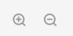

How to Adjust Register in Soundtrap:
Zoom in on the region you want to change
(zoom tools are on the bottom right)
Select Edit.

Slide 30
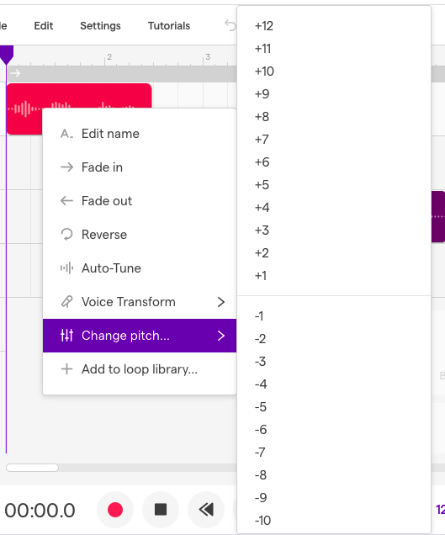
How to Adjust Register in Soundtrap:
Select Change pitch:
+ will raise the pitch
- will lower the pitch
The higher the number
the greater the change

Slide 31
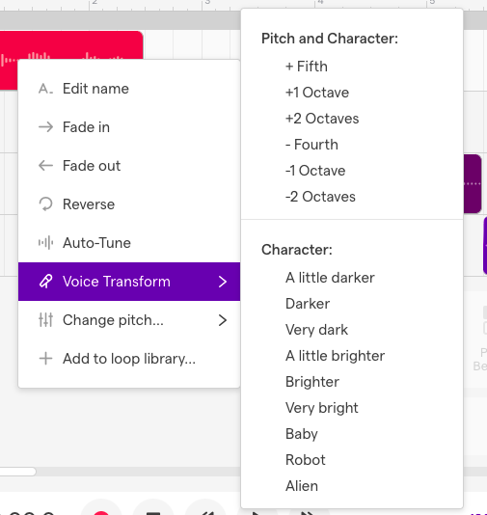
How to Adjust Register in Soundtrap:
OR SelectVoice Transform:
You can raise or lower the pitch
Or you can change the character
-Baby
-Robot
-etc.

Slide 32
Let’s Try It with Text:
Register
Register Key:
*pick a color to highlight each such as:
Low
Medium
High
One morning a mosquito saw an iguana drinking at a waterhole.
The mosquito said, “Iguana, you will never believe what I saw yesterday.”
“Try me,” said the iguana.
The mosquito said, “I saw a farmer digging yams that were as big as I am.”
“What’s a mosquito compared to a yam?” snapped the iguana grumpily.
“I would rather be deaf than listen to such nonsense!”
Then he stuck two sticks in his ears and went off, mek, mek, mek, mek, through the reeds.
Notes:
Ask the students what text should be low, medium, and high.

Slide 33
Let’s Try It with Text:
Register Sample
Register Key:
*pick a color to highlight each such as:
Low
Medium
High
One morning a mosquito saw an iguana drinking at a waterhole.
The mosquito said, “Iguana, you will never believe what I saw yesterday.”
“Try me,” said the iguana.
The mosquito said, “I saw a farmer digging yams that were as big as I am.”
“What’s a mosquito compared to a yam?” snapped the iguana grumpily.
“I would rather be deaf than listen to such nonsense!”
Then he stuck two sticks in his ears and went off, mek, mek, mek, mek, through the reeds.
Notes:
Sample to show students

Slide 34
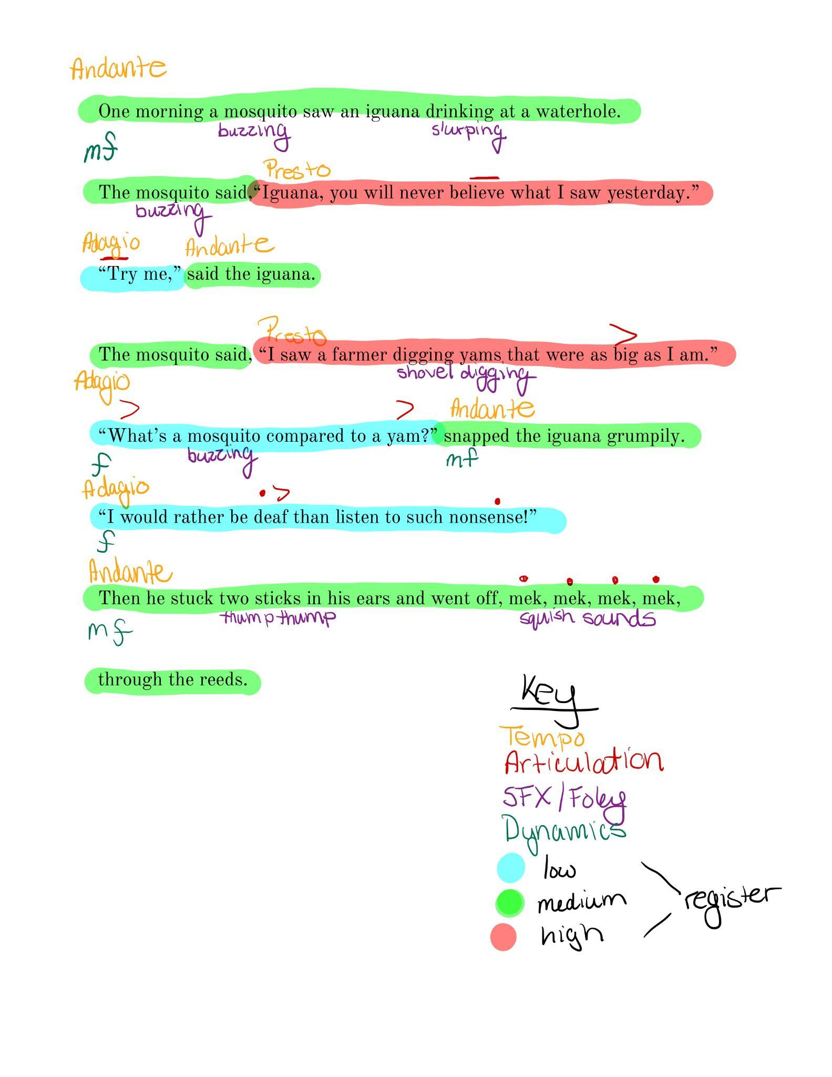
Let’s Try It with Text:
Sample with ALL
Notes:
Sample to show students

Slide 35
Assignment:
Pick a portion of a text and mark it in multiple places for:
Foley
Articulation
Dynamics
Tempo
Register
Record and produce the narration of your text.
Recordings should:
Include 4-5 sound effects (foley).
Use volume changes and ducking of sound to allow for the narration to be clearly heard.
Demonstrate the marked changes for articulation, dynamics, tempo, and register.
Includes an instrumental intro and outro.
Notes:
Determine with students whether the music for the intro and outro should be created via piano roll, recorded audio, or loops.

Slide 36
Rubric:
Areas for Improvement | Criteria Standards for this Performance | Evidence of Exceeding Standard
 | Draft: The text is marked appropriately in multiple places for foley, articulation, dynamics, tempo, and register.
 | Clarity: The narration is spoken clearly, without distortion and can be easily understood.
 | Musical Elements: The narration follows the draft for articulation, dynamics, tempo, and register to the best of the narrator’s ability..
 | Foley: Sound effects are used frequently, are well-timed, and make sense with the text
 | Intro/Outro Music: The music enhances and sets the mood for the narration without overpowering it.
 | Mix: The narration, music, and sound effects are blended very well together. The narration is the most prominent portion of the recording,
Notes:
-Use this single point mastery rubric or have students develop their own rubric using this as a starting point.

